Slide 1
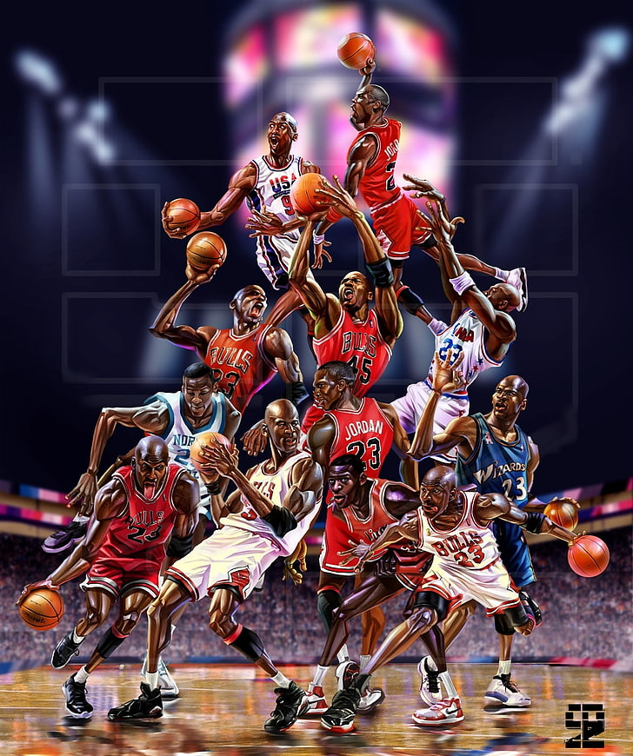
NBA Draft Prospect Prediction
A Machine Learning Approach to Identifying Global Talent
Presented by: Ofer A.
Date

Slide 2
Project Objective
Predict whether a basketball player has NBA potential using global player stats.
Target: At least 95% confidence in predictions.

Slide 3
Workflow Overview
• Data Preparation
• Exploratory Data Analysis (EDA)
• Data Cleaning
• Feature Engineering
• Feature Selection
• Model Selection
• Model Fine-Tuning

Slide 4
Data Preparation
- Cleaned and transformed text fields
- Created features: birth_year, NBA, draft_position
- Dropped: height, weight, PTS, etc.
- Reduced categorical noise in League & Nationality

Slide 5
Exploratory Data Analysis (EDA)
- AutoViz used for summaries
- Checked distribution & skewness
- Correlation heatmaps and t-statistics
- Analyzed target imbalance

Slide 6
Data Cleaning
- Outlier detection via IQR
- Missing values imputed using KNNImputer
- Dropped data-leaking features: League, Stage

Slide 7
Feature Engineering
- Created BMI
- Merged playoff and season stats
- Visualized draft sources and player roles

Slide 8
Feature Selection
- Methods: Lasso, Ridge, LinearSVC, GradientBoosting, RandomForest
- Dropped highly correlated or leaking features

Slide 9
Handling Imbalanced Data
- Used SMOTE for class balance
- One-hot encoding applied early in pipeline

Slide 10
Model Evaluation
- Metrics: Accuracy, Precision, Recall, F1 Score
- Models tested:
• Logistic Regression
• Decision Tree
• Random Forest
• XGBoost
• GradientBoost
• SVC, KNN, Naive Bayes, AdaBoost

Slide 11
Final Models & Fine-Tuning
- Used GridSearchCV for optimization
- Top performers:
• XGBClassifier
• GradientBoostingClassifier

Slide 12
Results Summary
- Strong performance achieved
- High precision and recall post-SMOTE and tuning

Slide 13
Future Work
- Add deep learning models (MLP, LSTM)
- Integrate scouting reports
- Validate with future draft classes

Slide 14
Questions
Thank you!
Open to any questions.

